Slide 1

Feature Extraction and Price Prediction for Mobile Phones

Slide 2
Feature Extraction and Price Prediction for Mobile Phones
Problem Statement:
You are part of a leading organization that specializes in selling mobile phones. In an increasingly competitive market, the company is looking to refine its pricing strategy by leveraging data to better understand what drives mobile phone prices.
Your objective is to develop a predictive model that can accurately estimate the price of a mobile phone based on its specifications. As part of this project, you will also conduct a feature importance analysis to identify which features most significantly impact pricing. The insights gained will support more informed pricing, inventory, and marketing decisions.

Slide 3
Introduction
In today’s fast-paced and highly competitive mobile phone market, pricing strategies play a critical role in attracting customers and maximizing sales. With the rapid evolution of mobile technology, devices now come with a wide range of specifications and features that significantly influence their market value. For businesses that sell mobile phones, understanding the key factors that drive pricing is essential for staying competitive and offering value to customers.
In this project, we work with a dataset containing detailed information about various mobile phones, including attributes such as model, color, memory, RAM, battery capacity, rear and front camera specifications, AI lens presence, mobile height, processor type, and price. The primary objective is to develop a predictive model that can accurately estimate the price of a mobile phone based on these features.
By applying machine learning techniques, we aim not only to build a robust price prediction model but also to perform feature extraction and analysis to identify which specifications most strongly influence pricing. These insights can support smarter pricing strategies, better product recommendations, and more informed business decisions.

Slide 4
Setting Up the Environment
Data exploration:
import pandas as pd
import numpy as np
import seaborn as sns
import matplotlib.pyplot as plt
import warnings
Processed_Flipdata = pd.read_excel(C:\Users\Suvam\Suvam Phone Price Project\'Processed_Flipdata.xlsx’)
# load first dataset
Processed_Flipdata
I complete my project in Google Colab, first i mount my drive with colab.
and after that load first data set.

Slide 5
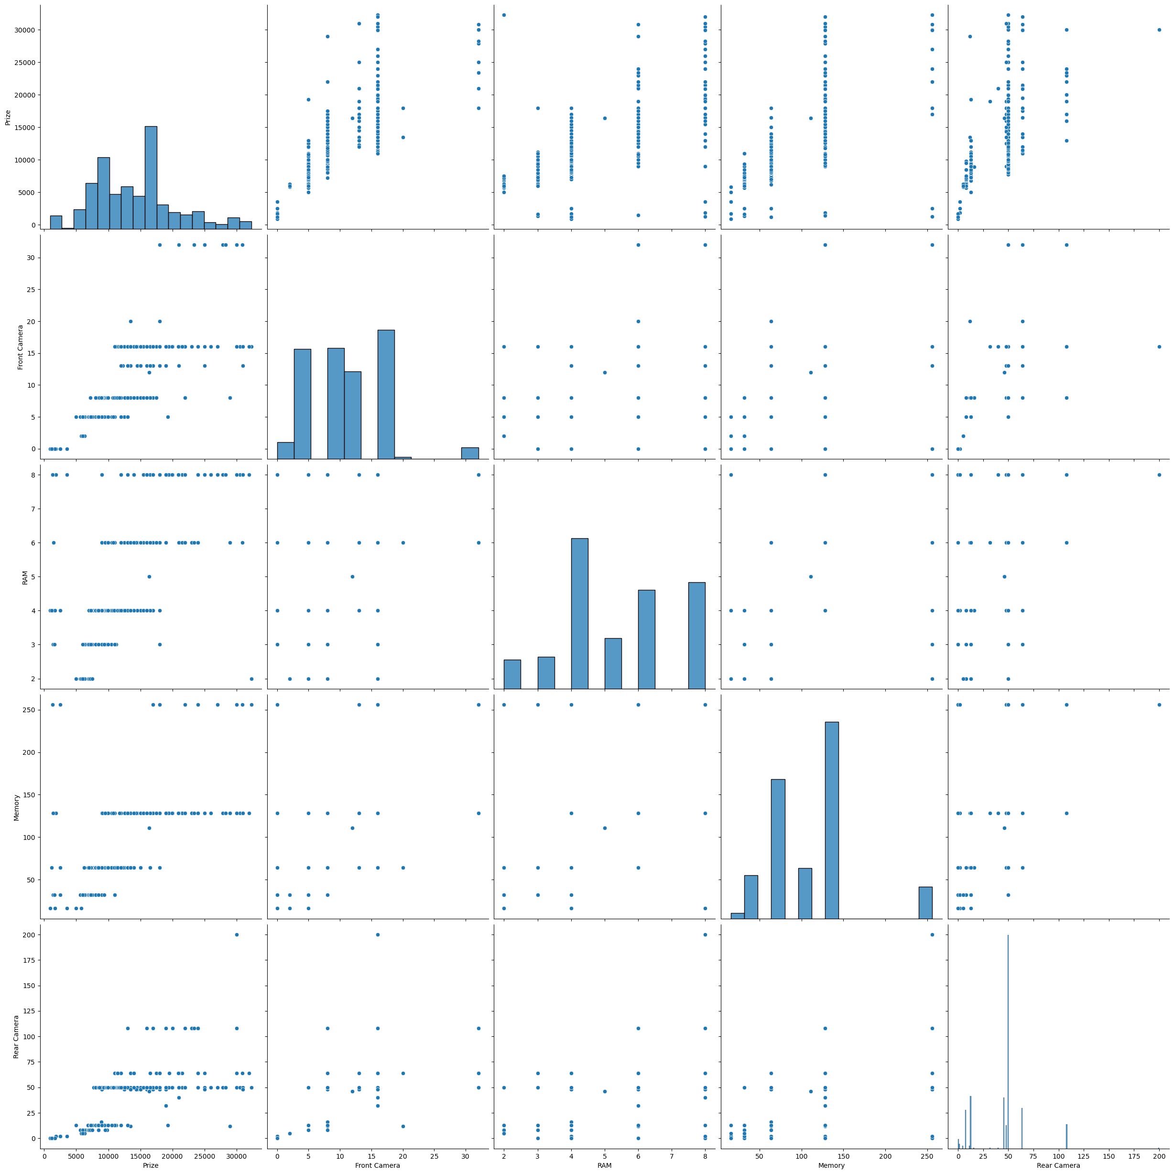
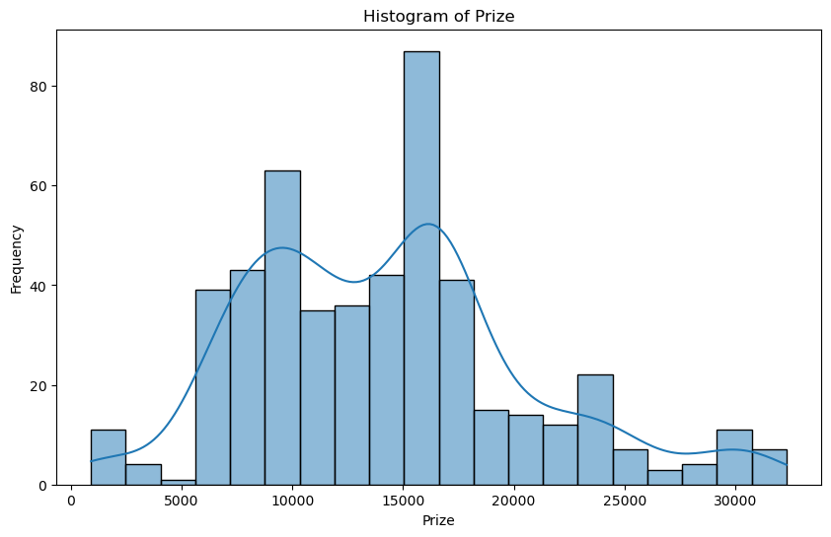
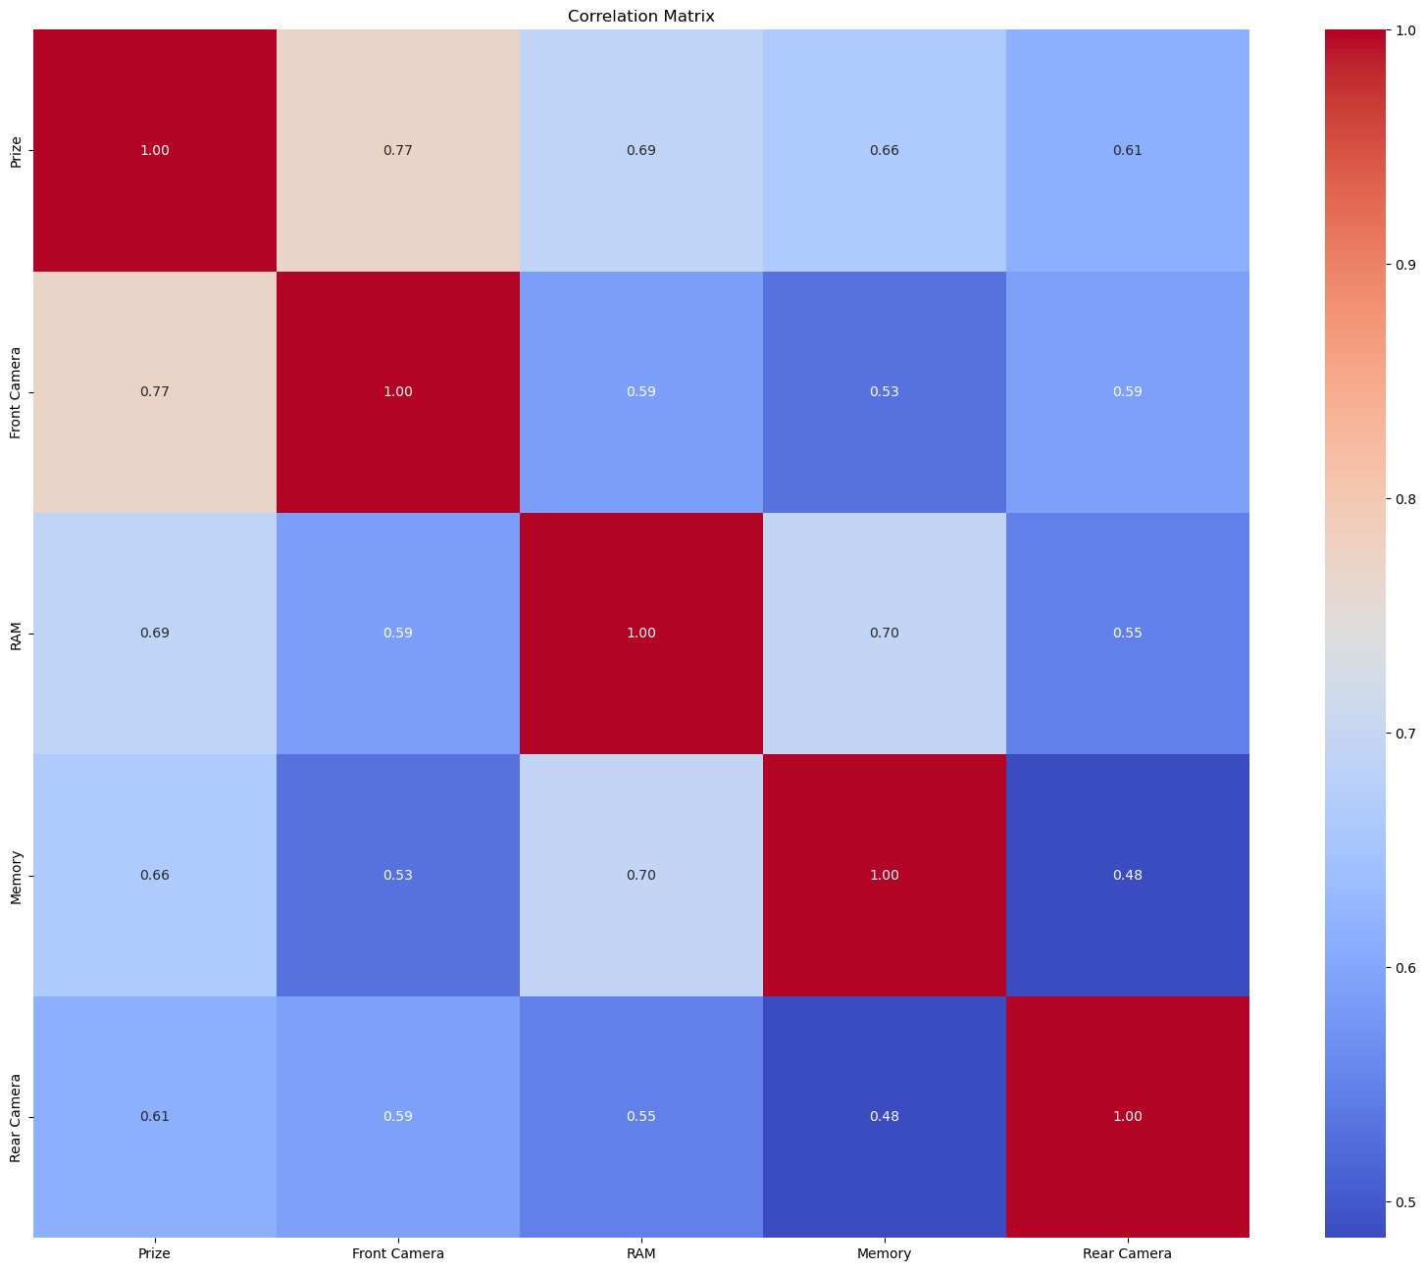
Feature Extraction
Feature extraction for mobile phone price prediction involves selecting key specifications like RAM, storage, camera, battery, and brand. These features are processed and used in machine learning models to estimate phone prices. This helps in accurate pricing, aiding manufacturers, retailers, and buyers in making informed decisions.

Slide 6
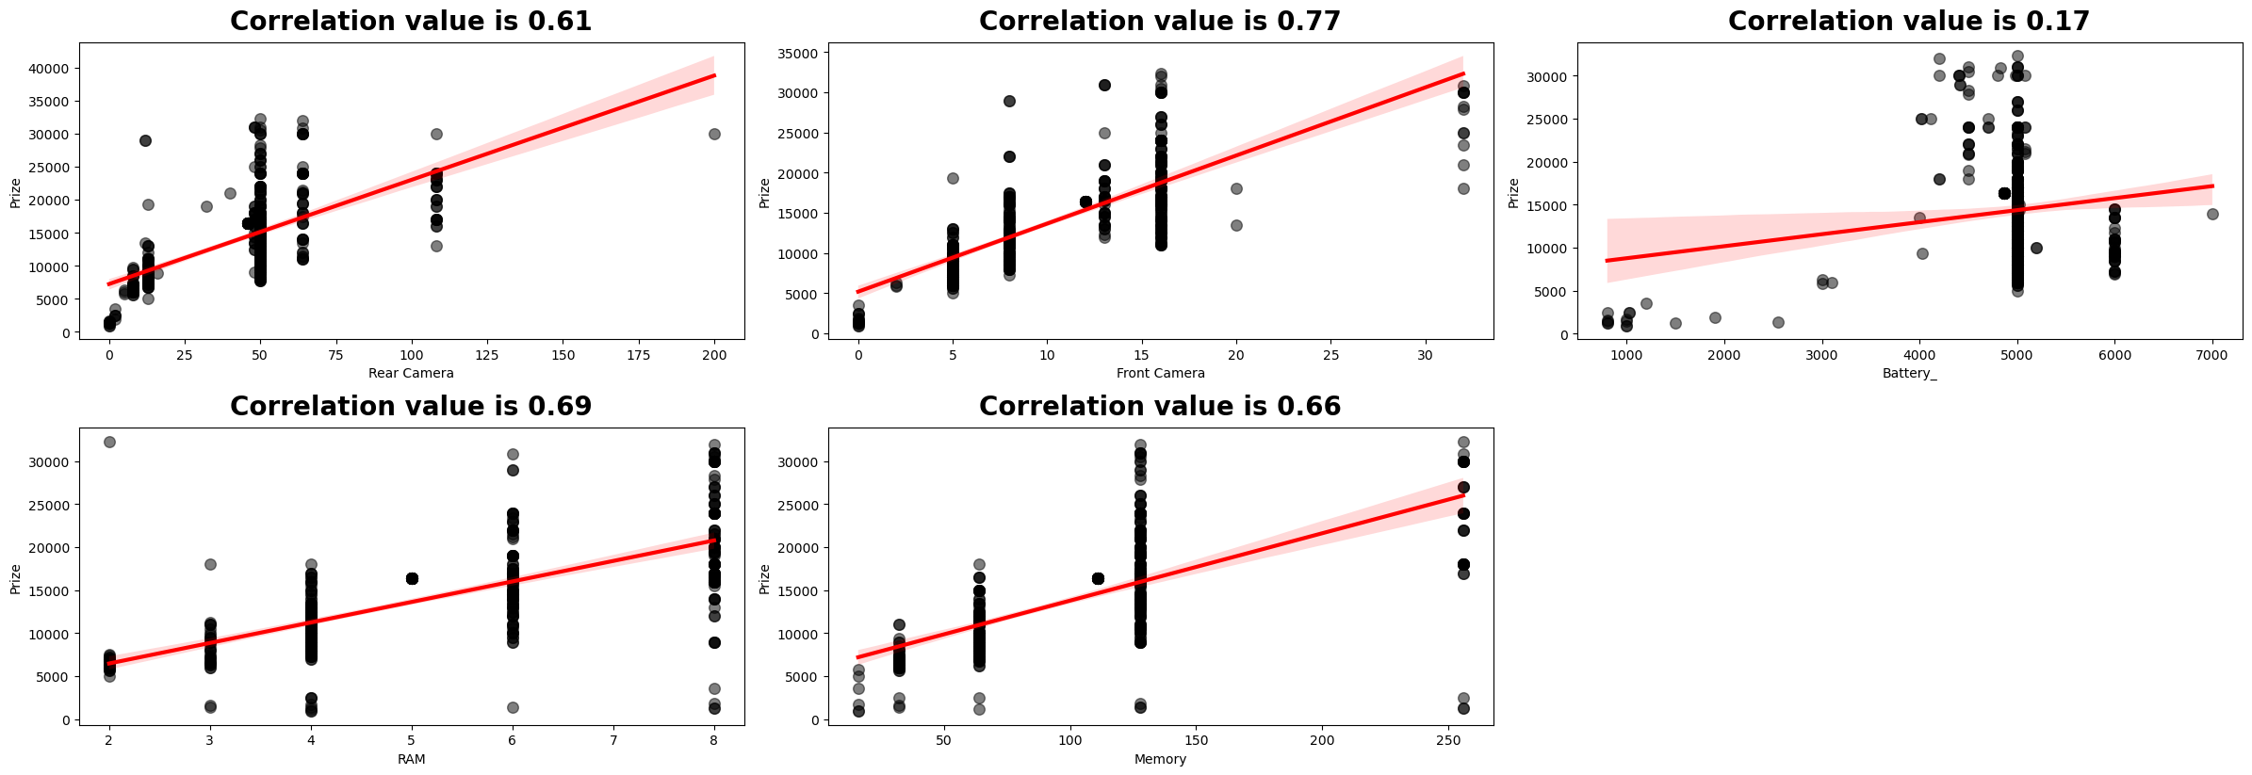
Model Building
"Model building involves selecting and training machine learning algorithms, like Linear Regression or Random Forest, using extracted features to predict mobile phone prices. The process includes data splitting, training, validation, and tuning to optimize accuracy, ensuring the model reliably estimates prices based on phone specifications."

Slide 7
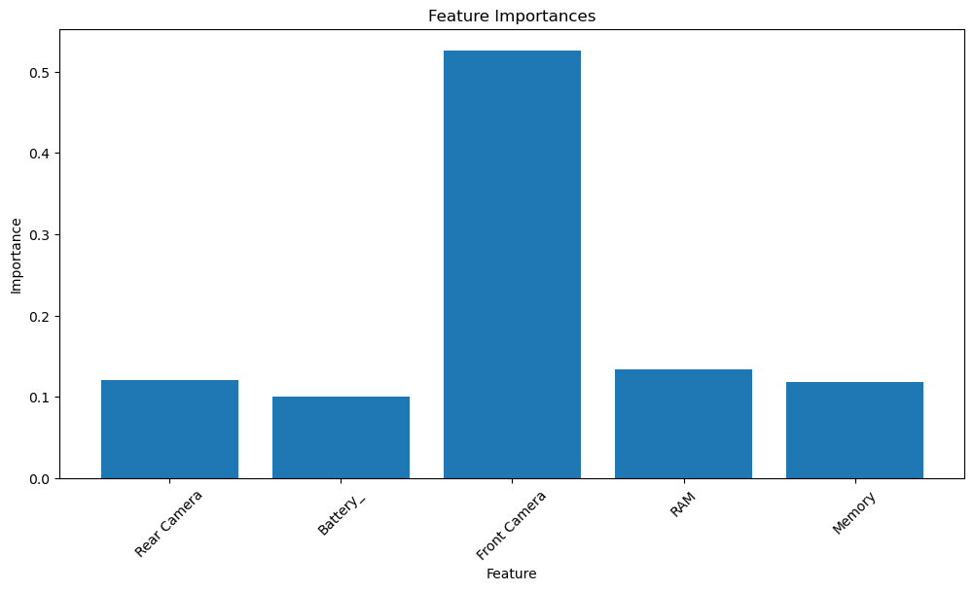
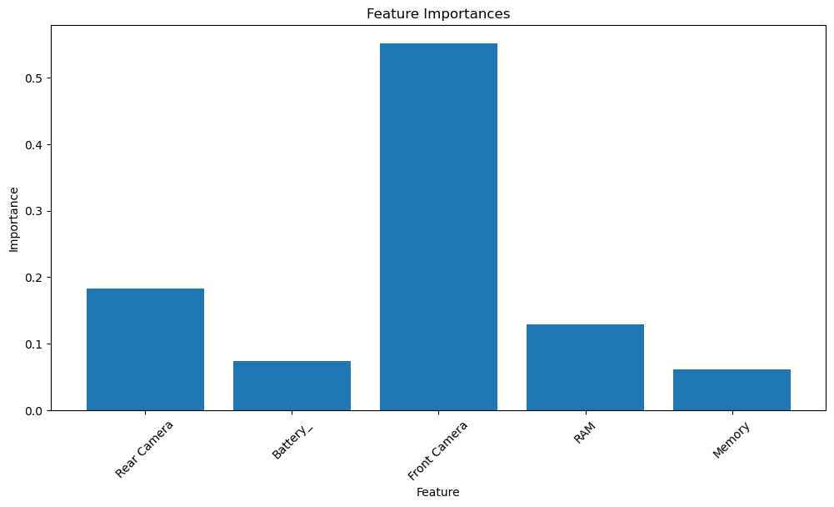
Feature Importance Analysis
Feature Importance Analysis identifies which mobile phone features most influence price predictions. By evaluating the impact of each attribute (e.g., RAM, camera, battery) on the model’s output, it helps prioritize key factors driving price variations. This insight improves model interpretability and guides feature selection for better accuracy.

Slide 8
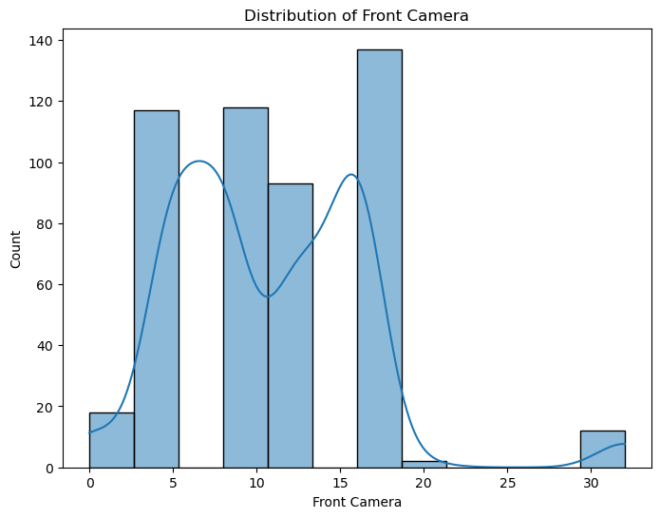
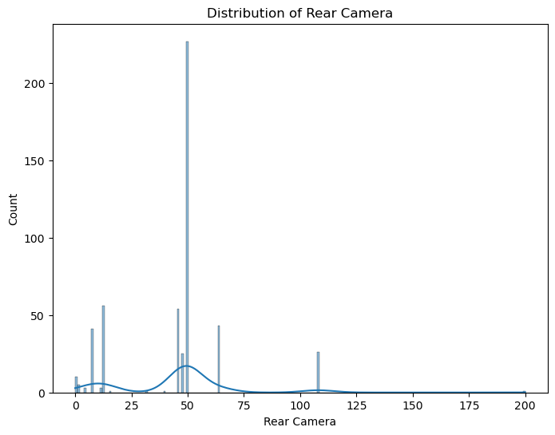
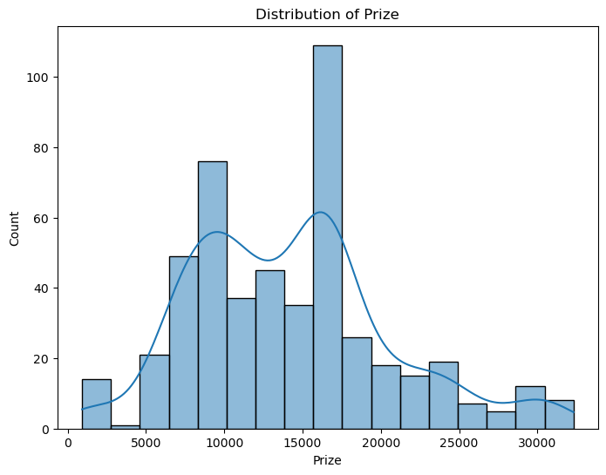
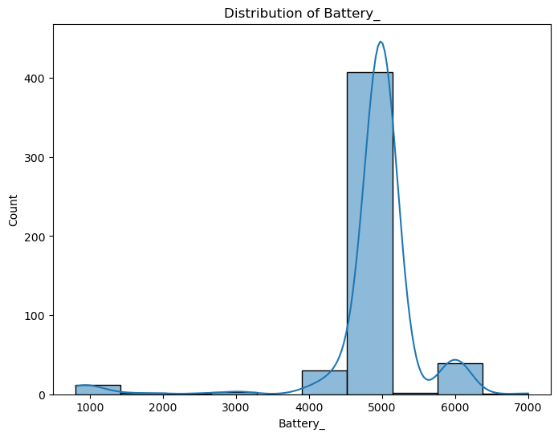
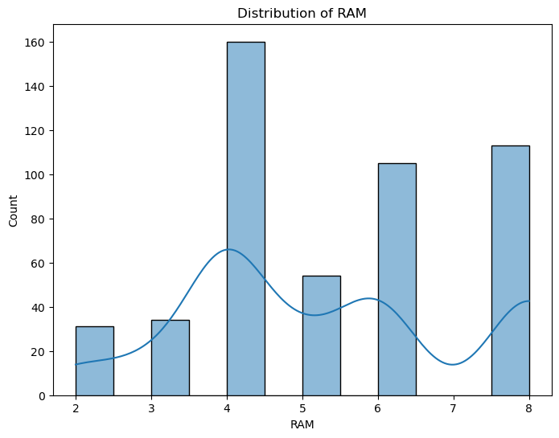
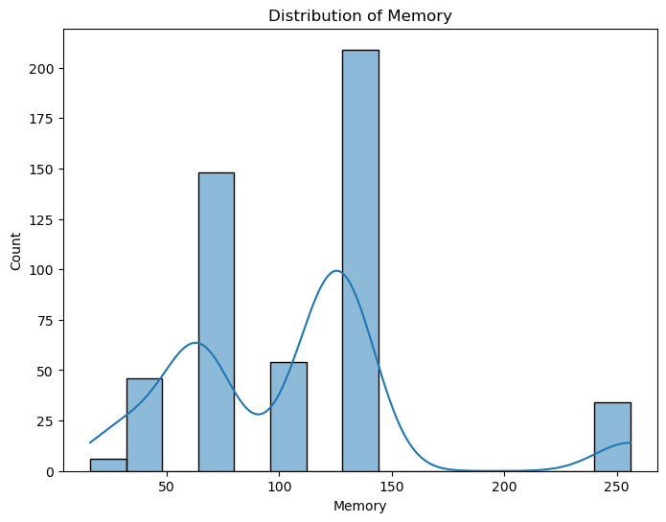
Visualization

Slide 9
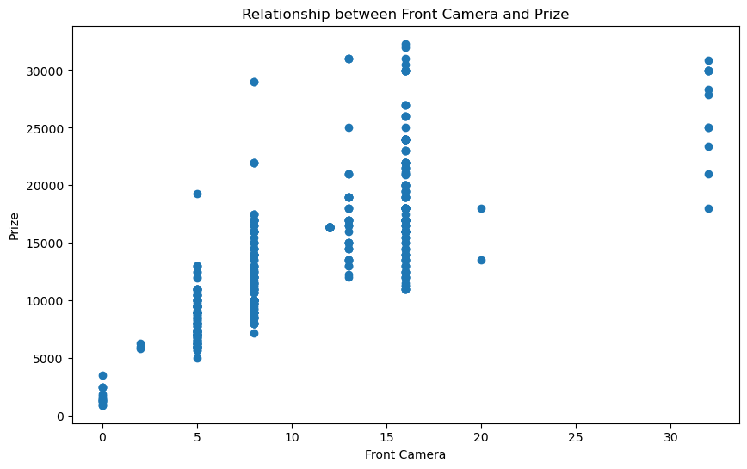
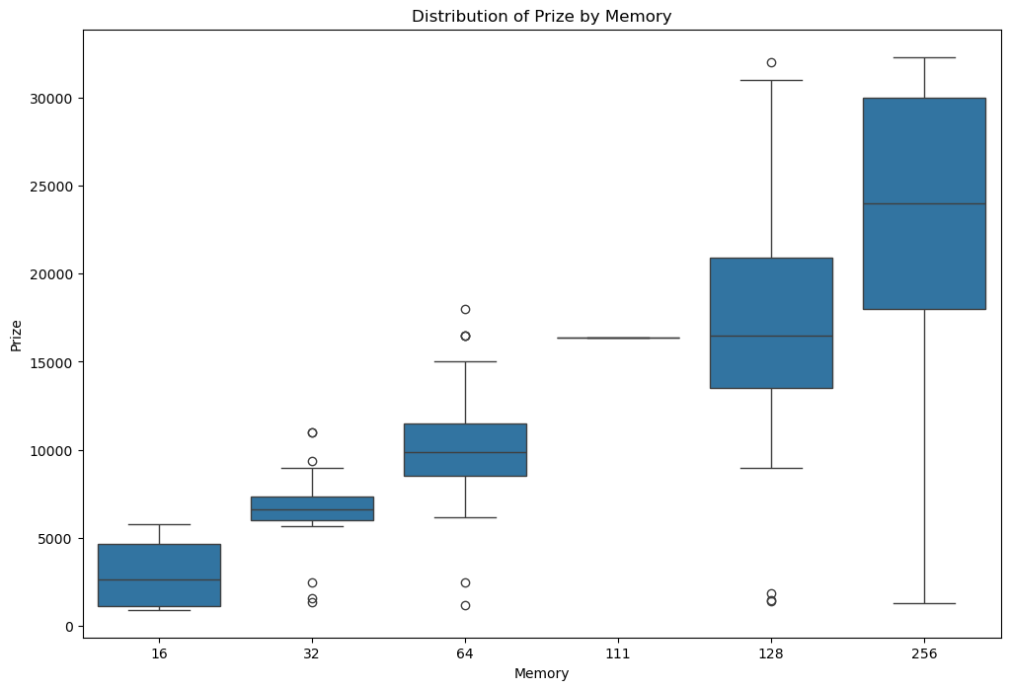
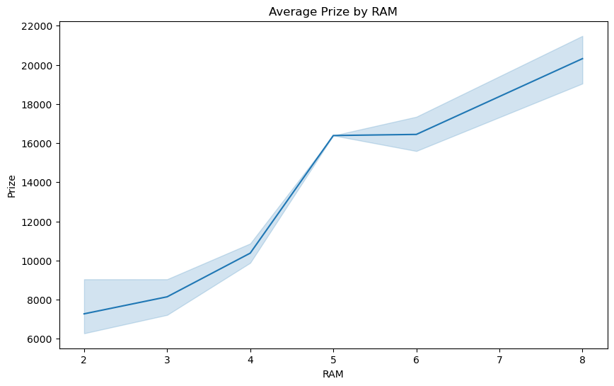
Visualization

Slide 10
Conclusion
1. Features like Front Camera , Memory and RAM are having strong relation with the target variable.
2. The best performing model is Random Forest Regressor Model with highest R2 & Adjusted_R2 Scores.
3. The second best performing model is Gradient Boosting Regressor Model.
4. The stacked model performance was impressive becuase of hight accuracy and low error rates.
5. The project developed a phones price prediction model with strong performance metrics.
6. The project effectively addresses the task of phone price prediction and contributes as a valuable tool in the dynamic real estate industry.

Slide 11
Thank You

